Slide 1





JAMstack
Boopalan Sundaramoorthy

Slide 2
What is the Jamstack?
"Jamstack" was originally cased as "JAMstack" where "JAM" stood for JavaScript, API & Markup.
”A modern web development architecture based on client-side JavaScript, reusable APIs, and prebuilt Markup“
— Mathias Biilmann (CEO & Co-founder of Netlify).

Slide 3
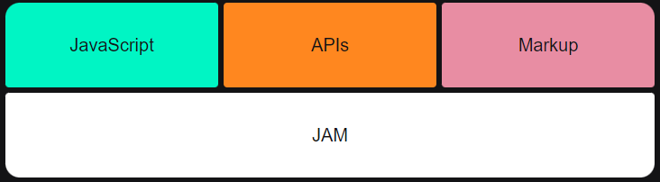
JavaScript Dynamic functionalities are handled by JavaScript. There is no restriction on which framework or library you must use.
APIs
Server side operations are abstracted into reusable APIs and accessed over HTTPS with JavaScript. These can be third party services or your custom function.
Markup
Websites are served as static HTML files. These can be generated from source files, such as Markdown, using a Static Site Generator.

Slide 4
Decoupled
The front end uses tooling separate from the back end. The front end is typically built using a static site generator. And the back end is often integrated with the front through the use of APIs used during the build process. Server-side processes can also be run using serverless functions.
Today, Jamstack is used to more broadly refer to an architectural approach for building websites. Though there are varying opinions on what exactly Jamstack means today, these attributes are present in most sites that claim to be Jamstack sites:
Static-first
While various practices exist for introducing dynamic elements to Jamstack sites, most are pre-rendered, which means the front end was built and compiled into HTML, CSS, and JavaScript files.
Progressively enhanced
JavaScript can be introduced to pre-rendered sites on an as-needed basis, thus increasing performance in the browser.

Slide 5
Benefits
Faster performance
Serve pre-built markup and assets over a CDN.
More secure
No need to worry about server or database vulnerabilities.
Less expensive
Hosting of static files is cheap or even free.
Better developer experience
Front end developers can focus on the front end, without being tied to a monolithic architecture. This usually means quicker and more focused development.
Scalability
If your product suddenly goes viral and has many active users, the CDN seamlessly compensates.

Slide 6
Best Practices
The following tips will help you leverage the best out of the stack.
Content delivery network
Since all the markup and assets are pre-built, they can be served via CDN. This provides better performance and easier scalability.
Atomic deploys
Each deploy is a full snapshot of the site. This helps guarantee a consistent version of the site globally.
Cache invalidation
Once your build is uploaded, the CDN invalidates its cache. This means that your new build is live in an instant.
Everything in version control
Your codebase lives in version control system, such as Git. The main benefits are changing the history of every file, collaborators and traceability.
Automated builds
Your server is notified when a new build is required, typically via webhooks. Server builds the project, updates the CDNs and the site is live.

Slide 7
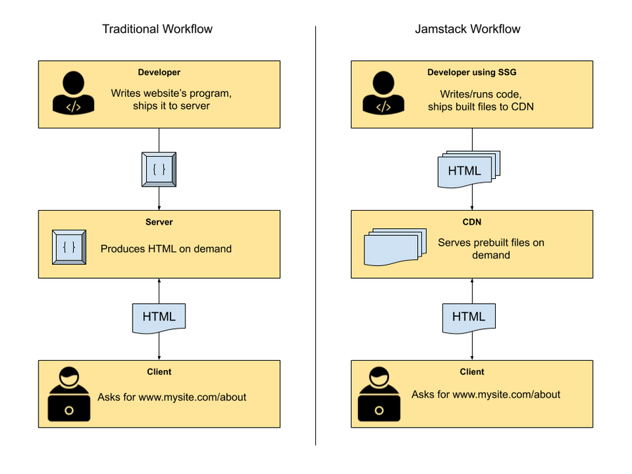
Workflow
Develop
Version Control
Automated Build
Static assets
Atomic deploy
Pre-render & invalidate cache
Update CDN

Slide 8
Coupled vs. Decoupled vs. Headless
COUPLED is when the content of a website is created, managed, and stored on the site’s back end, where the database lies (such as the WordPress admin). This content is then pulled from the back end and represented in the browser through a front-end interface (such as a WordPress template). In a way, a “coupled” application is the traditional “full-stack” with the back-end and front-end being different sides of the same app.

Slide 9
Coupled vs. Decoupled vs. Headless
In contrast, DECOUPLED is when the back end and the front end are managed separately — meaning that the database and management tools will be on one server, and the front-end somewhere else. Naturally, there needs to be a medium by which both are connected, which is normally an API. What’s more, since the back-end now is effectively separated from the front end, there could be, in fact, several front ends in different locations! (Think of different storefronts using the same engine, such as Shopify.)

Slide 10
Coupled vs. Decoupled vs. Headless
In a nutshell, HEADLESS software simply doesn’t have a front-end or a presentation layer. A headless CMS, for example, is one that could generate static content and push it anywhere: a mobile app, an Internet of Things device, a static website. Admittedly, this is also a “decoupled” situation, but here you might not even need an API. Think of a WordPress engine that exported its posts to be served as static HTML files: that’s headless.

Slide 11
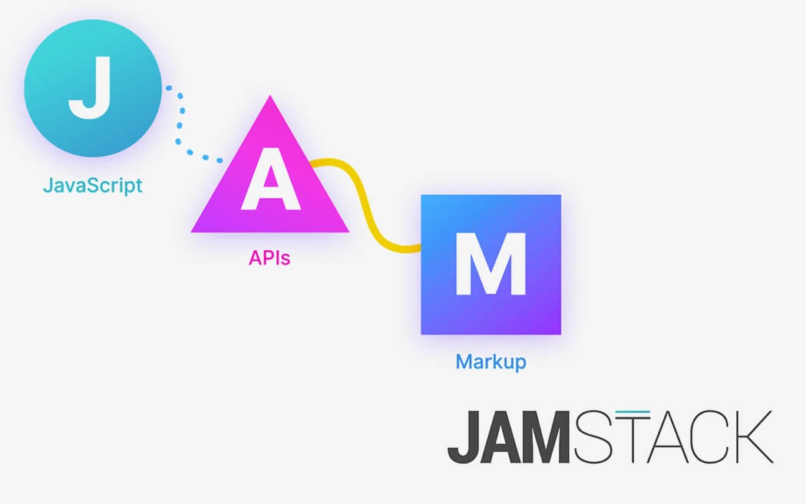
Getting Started
Jamstack

Slide 12
Development
However you decide to generate your HTML assets is up to you. The three most common approaches are:
Hand coding
Simple and effective method of writing HTML, it's ideal for super simple pages.
Static Site Generators
Most Jamstack sites are powered by a static site generator. There's no enforcement on which SSG you decide to use (Next.js, Gatsby, Hugo).
Site Builders
Tools that bring Jamstack to less technical users, while enabling developers to customize sites through modern tooling (Stackbit, Builder.io, CloudCannon).
See more SSGs

Slide 13
Deployment
Your built site needs to be hosted somewhere. There are great services that provide this for free and with ease.
Netlify
Vercel
Github Pages
Digital Ocean
Azure Static Web Apps
See more deployment services

Slide 14
Dynamic Parts
Jamstack websites don't have to be static. There are great services available to help bring some dynamic data to your product.
Custom functions
You can also abstract your own functions into reusable APIs.
AWS lambda functions
Netlify functions
Custom data
As you add features to your site, you may want to store user profiles, shopping cart data, game levels, or other dynamic data. There are many DBaaS (database as a service) tools out there today.
Fauna
Hasura
MongoDB Atlas & AWS DynamoDB

Slide 15
Dynamic Parts
Comments
Many Jamstack products have dynamic comment sections. These are typically used on blogs.
Staticman
Disqus
Forms
A great way to interact with your audience. Tools like Netlify support this by default, though there are other form-based services.
Netlify Forms
Getform
FormKeep

Slide 16
Dynamic Parts
E-Commerce
Setting up an online store on the Jamstack has never been easier.
Shopify
Snipcart
Commerce Layer
Search
Rely on third party services to integrate a search functionality.
Algolia
Fuse.js
Lunr.js
See more static services

Slide 17
CMS
Jamstack sites can also be controlled via a Content Management System, these are typically known as Headless CMS. Once a change in the CMS is made, a new build of your site will be triggered and then deployed as static assets.
Netlify CMS
Contentful
Ghost
Strapi
Forestry
Sanity.io
GraphCMS
See more CMS services

Slide 18


Getting Started
18

Slide 19
Hugo
Hugo is a static site generator (SSG) written in Go (aka Golang), a high-performance compiled programming language often used for developing backend applications and services.
Today, Hugo is capable of generating most websites within seconds (<1 ms per page). That explains why Hugo bills itself as “the world’s fastest framework for building websites.”

Slide 20
Hugo is Fast
In terms of raw performance, Hugo is the best static site generator in the world. Compared to Jekyll, Hugo was shown to be 35x faster by Forestry.
Similarly, Hugo can render a 10,000-page site in 10 seconds, a task that would take Gatsby over half an hour to complete.
Not only is Hugo the fastest SSG in terms of build times, but it’s also quick to install.
Hugo ships as a self-contained executable, unlike Jekyll, Gatsby, and other SSGs requiring installing dependencies with a package manager.

Slide 21
Templating is Easy in Hugo
“templating” refers to the process of adding placeholders for dynamic content insertion within an HTML page. To access the title of a page, you can use the {{ .Title }} variable. Thus, within a Hugo HTML template, it’s common to see the {{ .Title }} wrapped in H1 tags like so: <h1>{{ .Title }}</h1>
For templating, Hugo uses Go’s built-in html/template and text/template libraries. This helps cut down on application bloat because Hugo doesn’t need to install third-party libraries for templating.

Slide 22
Build a Instant Static Site with Hugo

Slide 23
How to Install Hugo on Windows
For Windows users, Hugo can be installed using either the Chocolatey or Scoop package managers.
After installing either Chocolatey or Scoop, you can install Hugo using one of the following commands (depending on your package manager):
choco install hugo-extended –confirm
scoop install hugo-extended
To verify that Hugo has been correctly installed, run the following command:
hugo version

Slide 24
Hugo Commands & Configuration
Hugo CLI Commands
hugo check – runs various verification checks
hugo config – displays the configuration for a Hugo site
hugo convert – converts content to different formats
hugo deploy – deploys your site to a cloud provider
hugo env – displays the Hugo version and environment information
hugo gen – provides access to various generators
hugo help – displays information about a command
hugo import – lets you import a site from another location
hugo list – displays a list of various content types
hugo mod – provides access to various module helpers
hugo new – lets you create new content for your site
hugo server – starts a local development server
hugo version – displays the current Hugo version

Slide 25
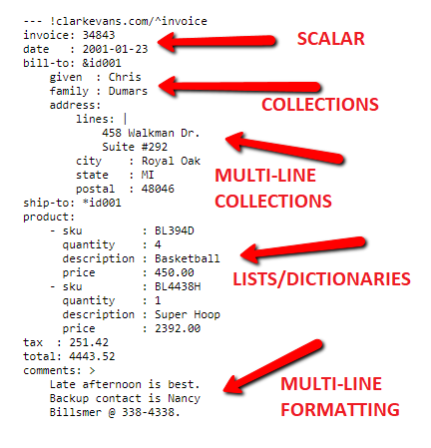
The Hugo Configuration File
Hugo’s configuration file supports three formats: YAML, TOML, and JSON. Likewise, the Hugo configuration file is config.yml, config.toml, or config.json, and you can find it in the root directory of a Hugo project.
Here’s what a typical Hugo configuration file in YAML format looks like:

Slide 26
YAML Vs. TOML Vs. JSON
YAML
Also for complex data, there is YAML. It was originally intended as a markup language (like HTML) but later repurposed for data.
Config files are a popular use for it.
It’s not a bad choice as its minimal syntax is nice. It is sensitive to indentation so it can give unexpected results or errors if indented improperly.
It also converts values to data types (string, number, boolean, date, etc) depending on the value. That’s not always okay. An app that worked for years might mysteriously stop working after a seemingly irrelevant config change.

Slide 27
YAML Vs. TOML Vs. JSON
YAML
Consider the following YAML file:
tv_shows:
- Seinfeld
- 24
- !!str 90210
All of these are TV show titles, so the app is expecting strings. But some of the values happen to be all digits so may be converted to integers.
Seinfeld is returned as type string, as expected. 24 is not; it’s returned as an integer. This could cause the app to crash, not when the YAML is parsed but when the app tries to use that value (the error message likely won’t be too helpful). 90210 is returned as type string, but only because the configurer knew and remembered to explicitly specify the data type using !!str.

Slide 28
YAML Vs. TOML Vs. JSON
TOML
Also for complex data, there is TOML. It also aims to be minimal but not so minimal that you can get into trouble indentation and data typing.
Although it needs a few more keystrokes, it is much simpler than YAML: compare all the bells & whistles in the YAML 1.2 spec vs the TOML spec.
It’s a great choice since it is fairly minimal, simple, and explicit.
Indentation is ignored by the parser.
Add indentation, if you want, to improve readability for humans.
It also has explicit syntax to get the data type you desire: strings, integers, floats, booleans, dates, times, etc. A little more typing (to quote strings, for example) but no surprises.

Slide 29
YAML Vs. TOML Vs. JSON
TOML
Consider the following TOML file:
tv_shows = [
"24",
"Seinfeld",
"90210",
]
As is expected by the app, all values are strings.

Slide 30
YAML Vs. TOML Vs. JSON
JSON
Also for complex data, there is JSON. It was devised to replace XML in AJAX calls in web apps. So its original intended use was for data interchange, not for config files.
But JSON does not allow comments! That’s fine for data interchange but definitely not fine for config files!
Because JSON does not allow comments, please do not choose JSON as your app’s config file format. For data interchange it’s okay; for config files it’s not.

Slide 31
How to Create a Hugo Site

Slide 32
How to Create a Hugo Site
To create a Hugo site, use the command below
hugo new site my-hugo-site
Next, navigate to the site folder, and you should see the following files and folders: config.toml file, archetypes folder, content folder, layouts folder, themes folder, data folder, and static folder.

Slide 33
How to Create a Hugo Site
Hugo’s config.toml File
Hugo’s primary configuration file contains global settings for your site.
Hugo’s Archetypes Folder
The archetypes folder is where you store content templates formatted in Markdown.
Archetypes are especially useful if your site has multiple content formats.
With Hugo archetypes, you can create a template for each content type on your site.
Without archetypes, you would have to manually specify the front matter parameters for every new post you create. While archetypes may seem complex and unnecessary at first, they can end up saving you a lot of time in the long run.

Slide 34
How to Create a Hugo Site
Hugo’s Content Folder
The content folder is where your actual post content goes.
Hugo supports both Markdown and HTML formats, with Markdown being the more popular option due to its ease of use. In addition to being the general storage space for posts, you can use the content folder to organize post content further.
Hugo treats each top-level directory in the content folder as a content section.
Content sections in Hugo are similar to custom post types in WordPress. For example, if your site has posts, pages, and podcasts, your content folder would have posts, pages, and podcasts directories where content files for these different post types would live.

Slide 35
How to Create a Hugo Site
Hugo’s Layout Folder
The layouts folder contains HTML files that define the structure of your site. In some cases, you may see a Hugo site without a layouts folder because it doesn’t have to be in the project’s root directory and can reside within a theme folder instead.
Similar to WordPress themes which use PHP for templating, Hugo templates consist of base HTML with additional dynamic templating powered by Golang’s built-in html/template and text/template libraries. The various HTML template files required for generating your site’s HTML markup are in the layouts folder.

Slide 36
How to Create a Hugo Site
Hugo’s Theme Folder
For sites that prefer a more self-contained way of storing template files and assets, Hugo supports a themes folder.
Hugo themes are similar to WordPress themes in that they’re stored in a themes directory and contain all the necessary templates for a theme to function.
While some Hugo users prefer keeping theme-related files in the project’s root directory, storing these files within the themes folder allows for easier management and sharing.

Slide 37
How to Create a Hugo Site
Hugo Data Folder
Hugo’s data folder is where you can store supplemental data (in JSON, YAML, or TOML format) that is needed to generate your site’s pages. Data files are beneficial for larger data sets that may be cumbersome to store directly in a content or template file.
Hugo Static Folder
Hugo’s static folder is where you store static assets that don’t require any additional processing. The static folder is typically where Hugo users store images, fonts, DNS verification files, and more. When a Hugo site is generated and saved to a folder for easy deployment, all files in the static folder are copied as-is.

Slide 38
How to Add a Theme to a Hugo Site

Slide 39
How to Add a Theme to a Hugo Site
Downloading and installing a premade theme is a great way to get started with Hugo. Hugo themes come in all shapes and sizes, and many of them are available for free on the official Hugo theme repository.
There are a lot of choices on https://themes.gohugo.io. My personal recommendation is to start with https://themes.gohugo.io/ghostwriter/
Avoid the git clone workflow they suggest on that page. You’ll surely be tweaking the theme in the future, and I find it best to have a single repository for both content and theme. It simplifies deployment.
So, go to https://github.com/jbub/ghostwriter/archive/master.zip to download the current version of the theme.
Then unpackage it in the themes/ghostwriter folder in your newly created Hugo website:

Slide 40
How to Add a Theme to a Hugo Site
Notice there is an exampleSite folder in the themes/ghostwriter. Open it, and open its content subfolder. In there, you can see the page, post and project subfolders.
Copy page and post in the content folder of the site and paste it in Hugo Site directory.

Slide 41
The configuration

Slide 42
The configuration
baseurl = "/"
title = "My blog"
theme = "ghostwriter"
[Params]
mainSections = ["post"]
intro = true
headline = "My headline"
description = "My description"
github = "https://github.com/XXX"
twitter = "https://twitter.com/XXX"
email = "XXX@example.com"
opengraph = true
shareTwitter = true
dateFormat = "Mon, Jan 2, 2006"
[Permalinks]
post = "/:filename/"
The sample data also provide a sample config.toml file in themes/ghostwriter/exampleSite/config.toml. This is the Hugo configuration file, which tells Hugo some details of the configuration without you having to hardcode information in the theme.
I suggest that you not copy that, because it has too many things, and instead use this:

Slide 43
Run the server
Now from the command line, run:
hugo serve
Open http://localhost:1313 in your browser, and you should be able to see the site live! The site home page displays.
There is a list of posts that is taken from the content/post folder of your website. You can open the file content/post/creating-a-new-theme.md to change anything in the post. If you save, the website will automatically update with the new content. You can create a new post by creating a new .md file, prefixing it with anything you want. You can use incremental numbers, if you prefer. Or use a date.

Slide 44
Run the server
If something doesn't look the way you want, you can open the themes/ghostwriter/layouts folder and tweak it. The “post” template is defined in themes/ghostwriter/layouts/post/single.html
Hugo uses Go templates. The syntax can be pretty unfamiliar but the Hugo website does a very good job at explaining them in this Go templates introduction.

Slide 45
Host your website with Github

Slide 46
Find a place to host your code
You need a GitHub account for this. If you have not made it yet, please create. The next thing to do is to create a repository on Github. Go to the repository and click “New”:
Next, upload your website folder there by going to the directory of your website and typing the following commands:
git init
git add .
git commit –m “first commit”
git remote add origin <url_of_your_repository>
git push –u origin master

Slide 47
Deploy your website with Netlify

Slide 48
Deploy your website with Netlify
Netlify is a web-developer platform that offers hosting and serverless backend services for web applications and static websites.
Netlify connects to your github accounts, goes through your git repository and copies all those codes over to Netlify. After that, it processes and publishes the site.
Step 1. Create a Netlify account
Step 2. Connect your Netlify account with your Github account.
Step 3. Deploy your site on Netlify.
After this process, Netlify will create a funny defaulted url — random_name.netlify.app for you. Click on the link to see that your website is now live! Congratuuuuulations!

